Slide 1
Software Engineering
Lecture 7

Slide 2
Agenda
System Modelling
Activity Diagram

Slide 3
System Modeling
User requirements should be written in natural language because they must be understood by people who are not technical experts. However, more detailed system requirements may be expressed in a more technical way.
One widely used technique is to document the system specification as a set of system models.
These models are graphical representations that describe business processes, the problem to be solved and the system that is to be developed.

Slide 4
System Modeling
Because of the graphical representations used, models are often more understandable than detailed natural language descriptions of the system requirements.
They are also an important bridge between the analysis and design processes.

Slide 5
System Modeling
You can use models in the analysis process to develop an understanding of the existing system that is to be replaced or improved or to specify the new system that is required.
You may develop different models to represent the system from different perspectives. For example:
An external perspective
An interaction perspective
A behavioral perspective
A structural perspective

Slide 6
An external perspective
The external perspective focuses on modeling the context or environment in which the system operates.
This includes identifying the external entities that interact with the system, such as users, other systems, and physical devices.
The external perspective aims to understand the system's interactions and dependencies with its environment.
It helps in defining the system's boundaries, interfaces, and external constraints that may impact its design and functionality.

Slide 7
Interaction Perspective
The interaction perspective involves modeling the interactions between the system and its environment or between the components within the system.
This perspective focuses on the flow of information, data, or control between different entities and how they communicate or collaborate with each other. Interaction diagrams, such as sequence diagrams or communication diagrams, can be used to represent the dynamic behavior and message exchanges between system components.

Slide 8
Behavioral Perspective
The behavioral perspective focuses on modeling the behavior of the system.
It captures the system's functionality, how it responds to events or inputs, and how it transitions from one state to another.
This perspective helps in understanding the system's business processes, use cases, and scenarios.
Various behavioral models can be used, such as use case diagrams, activity diagrams, state machine diagrams, or business process models, to represent the system's behavior from different viewpoints.

Slide 9
Structural Perspective
The structural perspective involves modeling the architecture of the system or the structure of the data processed by the system.
It focuses on the static elements of the system, such as its components, subsystems, modules, classes, or database schemas.
This perspective helps in understanding the system's organization, relationships between components, and data structures.
Structural models like class diagrams, component diagrams, or entity-relationship diagrams can be used to represent the system's structure and its static relationships.

Slide 10
Types of System Models
Different types of system models are based on different approaches to abstraction.
Examples of the types of system models that you might create during the analysis process are:
A data-flow model
A composition model
An architectural model
A classification model
A stimulus-response model

Slide 11
Data-Flow Model
A data-flow model represents how data moves and is processed within a system.
It focuses on the flow of data between different components or processes in the system.
Data-flow diagrams (DFDs) are commonly used to depict the flow of data through various processes, data stores, and external entities.
DFDs illustrate the inputs, outputs, and transformations of data, providing a visual representation of how information is exchanged and processed within the system.

Slide 12
Composition Model
A composition or aggregation model shows how entities in the system are composed of other entities.
It focuses on the hierarchical structure or relationships between system components.
In object-oriented design, composition models can be represented using class diagrams, where classes represent entities, and their relationships indicate how they are composed or aggregated.
This model helps in understanding the organization and composition of system components, providing insights into their interactions and dependencies.

Slide 13
Architectural Model
An architectural model represents the high-level structure and organization of a system.
It highlights the principal sub-systems or modules that make up the system and shows how they interact with each other.
Architectural models help in understanding the system's overall design, the distribution of responsibilities, and the communication paths between different components.
Diagrams like block diagrams or component diagrams are often used to visualize the architecture of a system.

Slide 14
Classification Model
A classification model, such as an object class or inheritance diagram, represents how entities in the system are classified or organized based on their common characteristics.
It focuses on the inheritance relationships and the hierarchy of classes or objects in an object-oriented system.
This model helps in understanding the classification and categorization of entities, their attributes, and the inheritance of properties and behaviors from parent classes.

Slide 15
Stimulus-Response Model
A stimulus-response model, also known as a state transition diagram or state machine diagram, shows how the system reacts to internal and external events.
It represents the different states that a system can be in and the transitions between those states triggered by events.
This model captures the system's behavior and how it responds to various inputs or conditions.
State transition diagrams are useful for understanding the dynamic behavior and temporal aspects of a system.

Slide 16
Unified Modeling Language
UML stands for Unified Modeling Language.
It is a standardized visual modeling language used in software engineering to design, specify, visualize, and document software systems.
UML provides a set of graphical notations that represent different aspects of a system, allowing software developers, analysts, and designers to communicate and understand the system's structure, behavior, and interactions.
UML diagrams are used to depict various perspectives of a software system, including its static structure, dynamic behavior, and the interactions between different components.

Slide 17
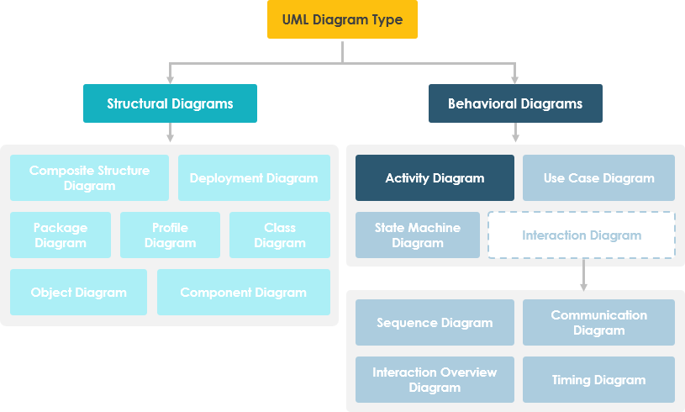
UML Diagrams for System Modeling

Slide 18
UML Diagrams for System Modeling
Five types of UML diagrams that are the most useful for system modeling:
Activity diagrams
which show the activities involved in a process or in the data processing.
Use case diagrams
which show the interactions between a system and its environment.
Sequence diagrams
which show interactions between actors and the system and between system components.
Class diagrams
which shows the object classes in the system and the associations between these classes.
State diagrams
which show how the system reacts to internal and external events.

Slide 19
Activity Diagram

Slide 20
Activity Diagram
It is basically a flowchart to represent the flow from one activity to another activity.
The activity can be described as an operation of the system.
The basic purpose of activity diagrams is to capture the dynamic behavior of the system.
It is also called object-oriented flowchart.
This UML diagram focuses on the execution and flow of the behavior of a system instead of implementation.
Activity diagrams consist of activities that are made up of actions that apply to behavioral modeling technology.

Slide 21

Activity Diagram Notations and Symbols
Initial State or Start Point
A small filled circle followed by an arrow represents the initial action state or the start point for any activity diagram.

Slide 22
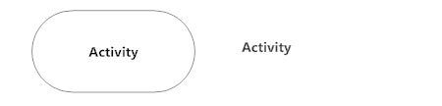
Activity Diagram Notations and Symbols
Activity or Action State
An action state represents the non-interruptible action of objects.

Slide 23

Activity Diagram Notations and Symbols
Action Flow
Action flows, also called edges and paths, illustrate the transitions from one action state to another. They are usually drawn with an arrowed line.

Slide 24
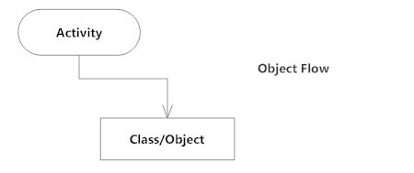
Activity Diagram Notations and Symbols
Object Flow
Object flow refers to the creation and modification of objects by activities. An object flow arrow from an action to an object means that the action creates or influences the object. An object flow arrow from an object to action indicates that the active state uses the object.

Slide 25

Activity Diagram Notations and Symbols
Decisions and Branching
A diamond represents a decision with alternate paths. When an activity requires a decision prior to moving on to the next activity, add a diamond between the two activities. The outgoing alternates should be labeled with a condition or guard expression. You can also label one of the paths "else."

Slide 26
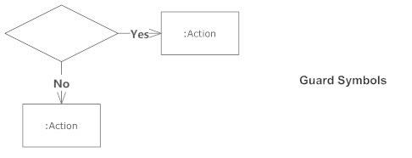
Activity Diagram Notations and Symbols
Guards
In UML, guards are a statement written next to a decision diamond that must be true before moving next to the next activity. These are not essential, but are useful when a specific answer, such as "Yes, three labels are printed," is needed before moving forward.

Slide 27
Activity Diagram Notations and Symbols
Synchronization
A fork node is used to split a single incoming flow into multiple concurrent flows. It is represented as a straight, slightly thicker line in an activity diagram.
A join node joins multiple concurrent flows back into a single outgoing flow.
A fork and join mode used together are often referred to as synchronization.

Slide 28
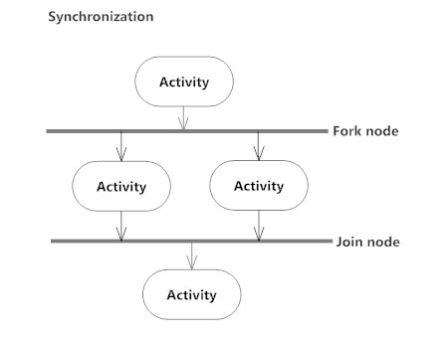
Activity Diagram Notations and Symbols
Synchronization

Slide 29
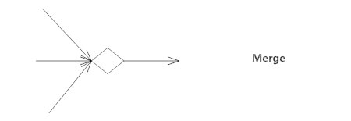
Activity Diagram Notations and Symbols
Merge Event
A merge event brings together multiple flows that are not concurrent.

Slide 30
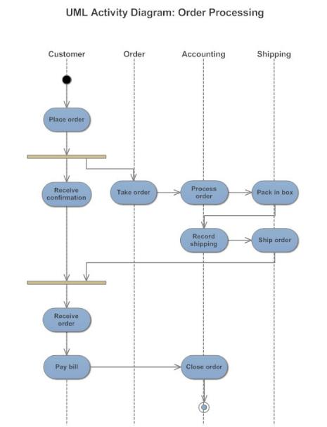
Activity Diagram Notations and Symbols
Swimlanes
Swimlanes group related activities into one column.

Slide 31
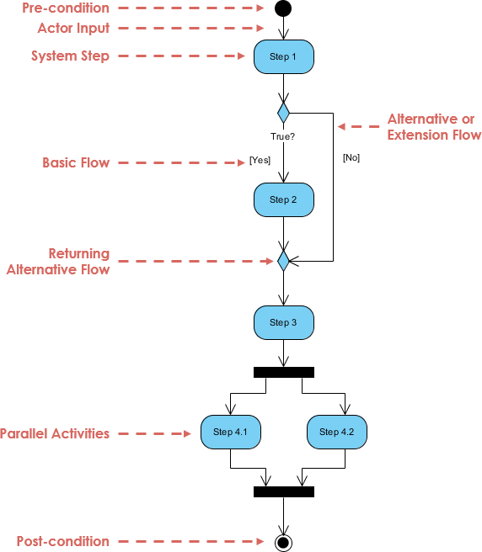
A basic activity diagram

Slide 32
Modeling a Word Processor
The activity diagram example below describes the workflow for a word process to create a document through the following steps:
Open the word processing package.
Create a file.
Save the file under a unique name within its directory.
Type the document.
If graphics are necessary, open the graphics package, create the graphics, and paste the graphics into the document.
If a spreadsheet is necessary, open the spreadsheet package, create the spreadsheet, and paste the spreadsheet into the document.
Save the file.
Print a hard copy of the document.
Exit the word processing package.

Slide 33
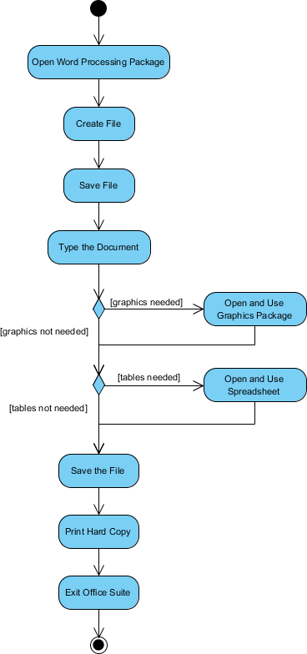
Modeling a Word Processor

Slide 34
Process Order - Problem Description
Once the order is received, the activities split into two parallel sets of activities. One side fills and sends the order while the other handles the billing.
On the Fill Order side, the method of delivery is decided conditionally. Depending on the condition either the Overnight Delivery activity or the Regular Delivery activity is performed.
Finally, the parallel activities combine to close the order.

Slide 35
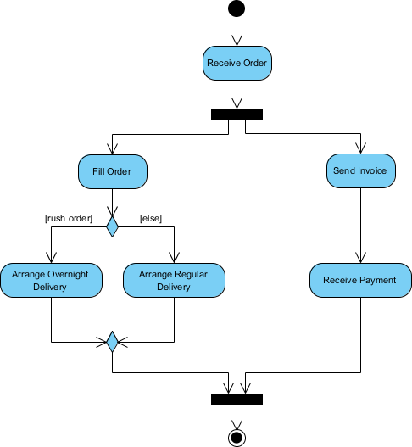
Process Order - Problem Description

Slide 36
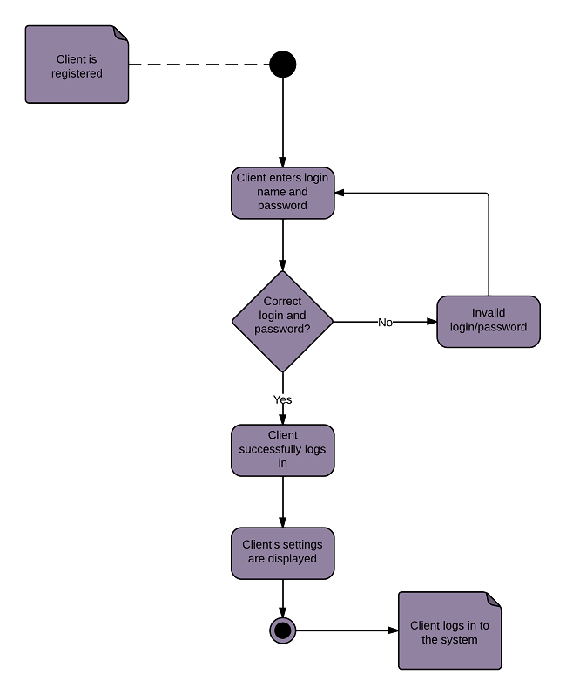
Login Page
Notes:
Note Symbol

Slide 37
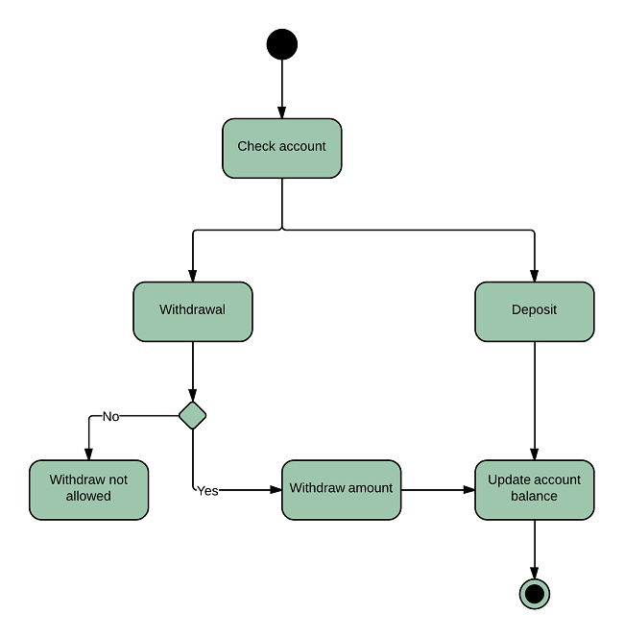
Bank Account

Slide 38
Questions?

